Slide 1
Predicting Customer Behavior Phase 2
Jarrod Lott
UMBC
DAT 606
Fall 2020

Slide 2

Overview
Project Refresher
Visualizations and Patterns
Model
Next Steps

Slide 3
Project Refresher
Topic
Predict customer behavior for banking customers

Slide 4

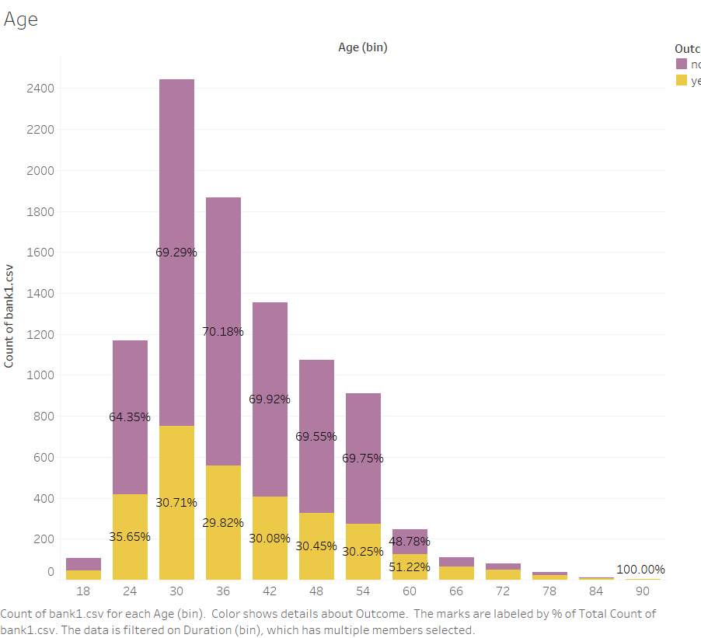
Visualizations and Patterns
Age
Under 30
Over 60

Slide 5
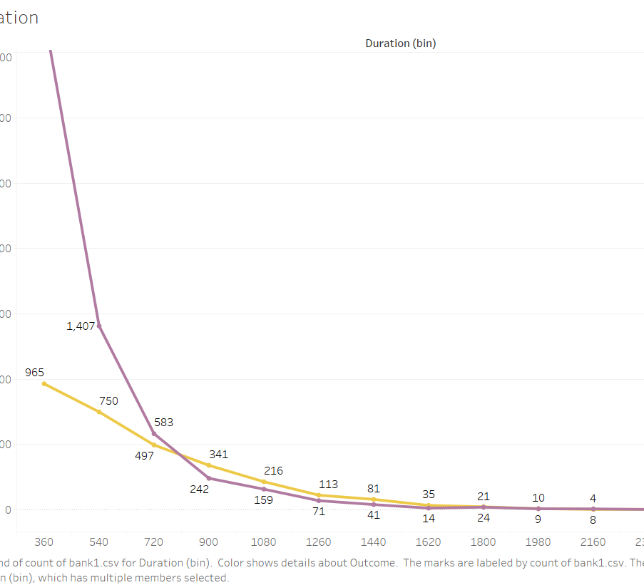
Visualizations and Patterns
Call Duration
6 Minutes is the key

Slide 6
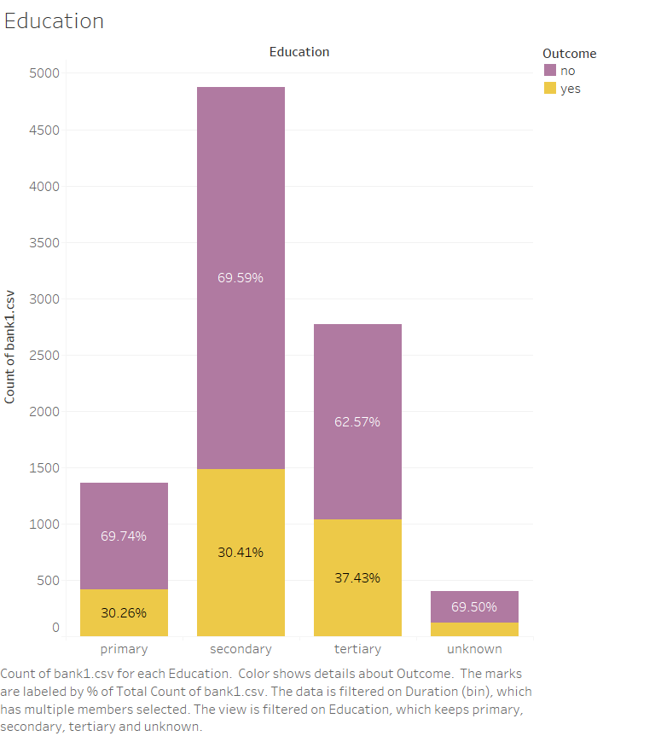
Visualizations and Patterns
Education
College graduates

Slide 7
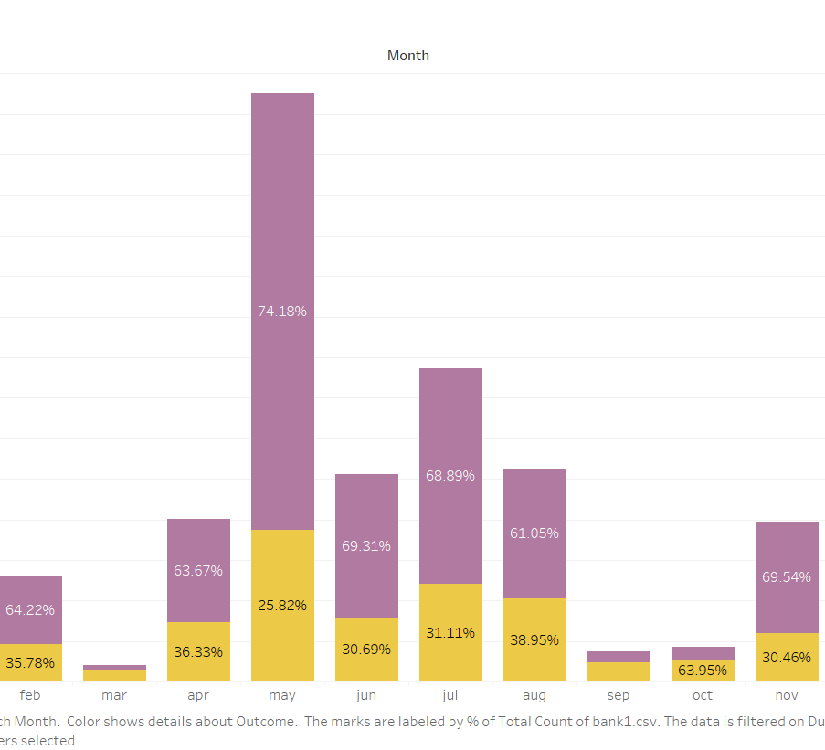
Visualizations and Patterns
Month
High effort and lower return for May – Jul
Possible shift of effort to Aug - Oct

Slide 8
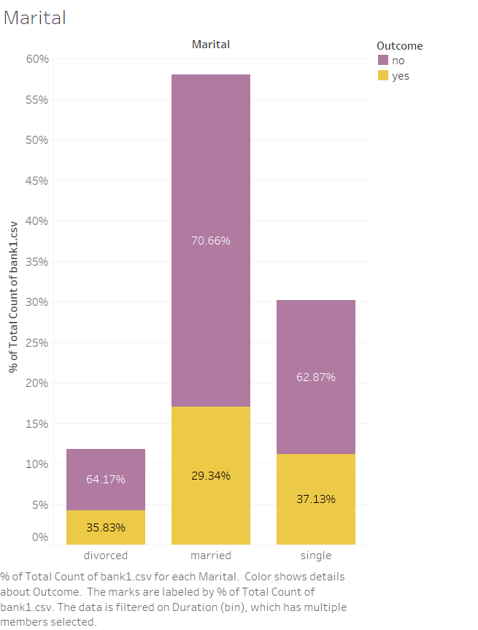
Visualizations and Patterns
Marital
Focus on people who do not have to share decision making

Slide 9
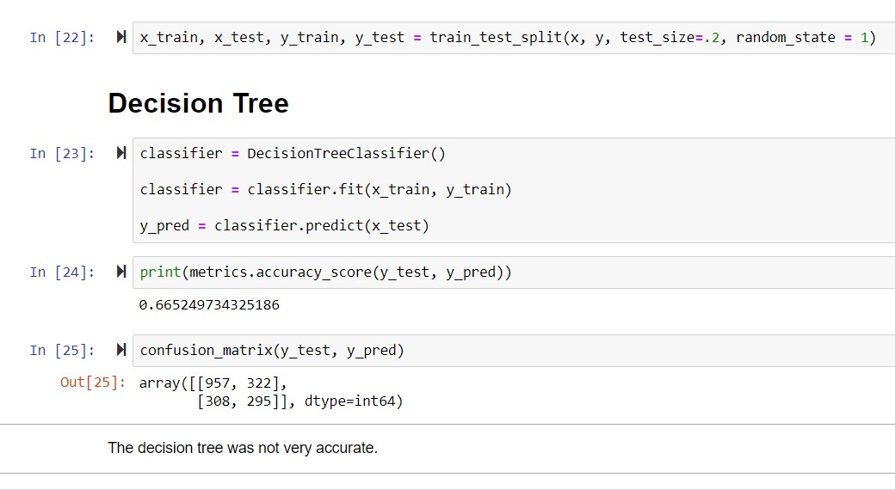
Model
Decision Tree
Poor performance

Slide 10
Next Steps
Run Different Tests
KNN
Naïve Bayes
Random Forest

Slide 11
Review
Project Refresher
Visualizations and Patterns
Model
Next Steps

